Slide 1
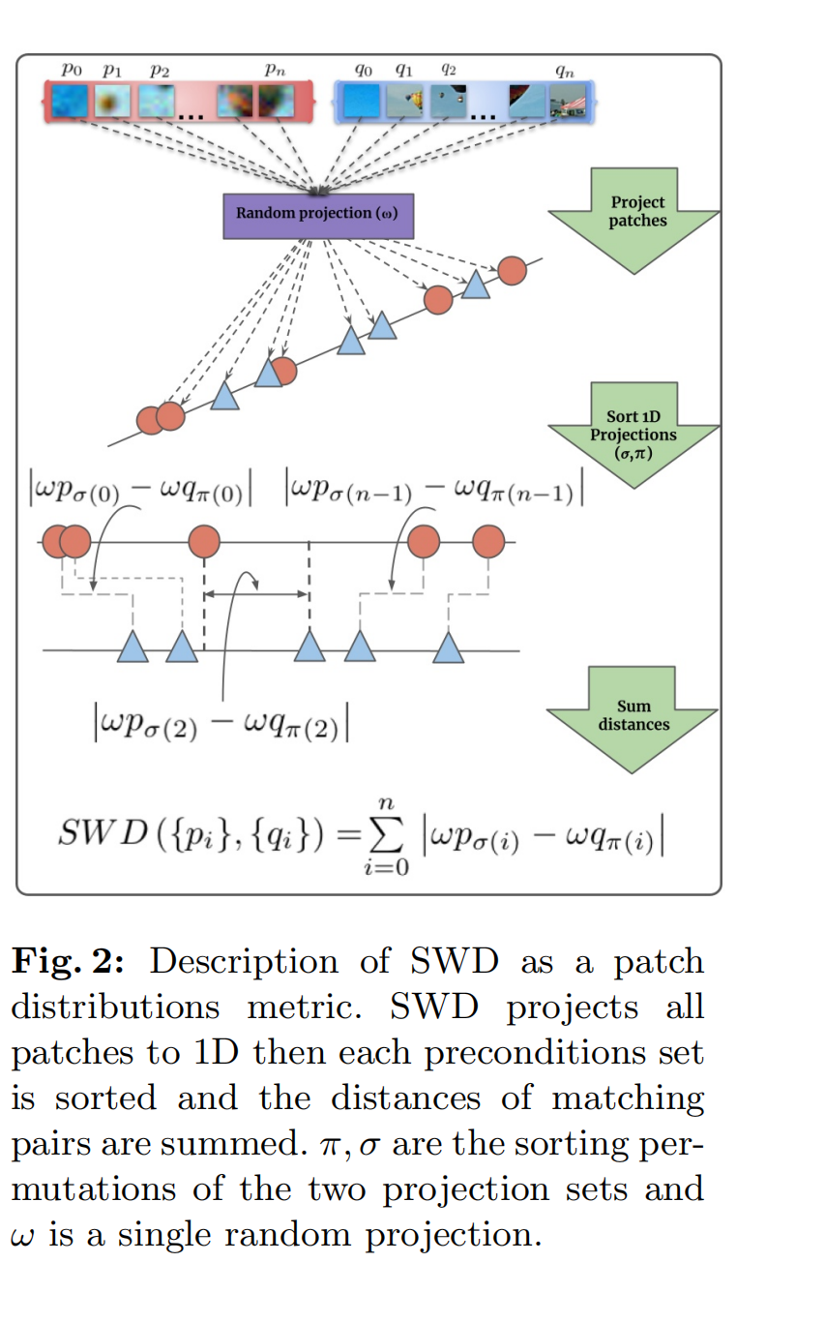
Sliced Wasserstein Distance (SWD)

Slide 2
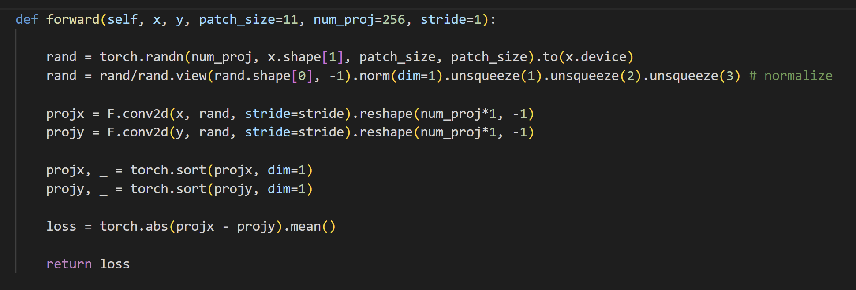
SWD
Patch size: 5*5
Projection directions: 256
(i.e., Filter: 256*input_channels*5*5)

Slide 3
Deep Features
256*256
128*128
64*64
32*32
16*16
VGG features
Scale1
Scale2
Scale3
Scale4
Scale5
Stage1
f3
f4
f5
f2
f1
256 512 512
128
Stage2
64
f1
64
Stage3
f2
192
f3
Stage4
448
: Gaussian Filter with stride 2
f4
Stage5
960
f5
1472

Slide 4
SWD
Patch size: 5*5
Projection directions: 256
(i.e., Filter: 5*5*input_channels*256)
 |  | LIVE | CSIQ | TID2013 | KADID | TQD
Raw pixels | 5*5*3*256 random | 0.828 | 0.670 | 0.476 | 0.381 | 0.465
 | 5*5*3*128 random + 5*5*3*128 learned | 0.884 | 0.725 | 0.587 | 0.444 | 0.554
 | 5*5*3*256 learned | 0.889 | 0.728 | 0.610 | 0.486 | 0.651
Gaussian Pyramid X=3,3,3,3,3 | 5*5*(X)*256 random | 0.878 | 0.681 | 0.529 | 0.348 | 0.285
 | 5*5*(X)*128 random + 5*5*(X)*128 learned | 0.836 | 0.736 | 0.620 | 0.681 | 0.714
 | 5*5*(X)*256 learned | 0.829 | 0.757 | 0.641 | 0.693 | 0.726
Laplacian Pyramid X=3,3,3,33 | 5*5*(X)*256 random | 0.825 | 0.707 | 0.528 | 0.491 | 0.589
 | 5*5*(X)*128 random + 5*5*(X)*128 learned | 0.850 | 0.735 | 0.621 | 0.655 | 0.700
 | 5*5*(X)*256 learned | 0.851 | 0.745 | 0.647 | 0.667 | 0.705

Slide 5
SWD
Patch size: 5*5
Projection directions: 256
(i.e., Filter: 5*5*input_channels*256)
 |  | LIVE | CSIQ | TID2013 | KADID | TQD
Pretrained VGG X=64,128,256,512,512 | 5*5*(X)*256 random | 0.887 | 0.894 | 0.653 | 0.715 | 0.835
 | 5*5*(X)*128 random+ 5*5*(X)*128 learned | 0.920 | 0.933 | 0.775 | 0.899 | 0.828
 | 5*5*(X)*256 learned | 0.926 | 0.935 | 0.777 | 0.908 | 0.831
Pretrained EffNet X=32,48,80,160,224 | 5*5*(X)*256 random | 0.940 | 0.888 | 0.629 | 0.722 | 0.905
 | 5*5*(X)*128 random+ 5*5*(X)*128 learned | 0.955 | 0.921 | 0.787 | 0.942 | 0.912
 | 5*5*(X)*256 learned | 0.963 | 0.922 | 0.788 | 0.947 | 0.911
Pretrained PNAS X=96,270,540,1080 | 5*5*(X)*256 random | 0.946 | 0.918 | 0.649 | 0.751 | 0.836
 | 5*5*(X)*128 random+ 5*5*(X)*128 learned | 0.955 | 0.927 | 0.770 | 0.905 | 0.832
 | 5*5*(X)*256 learned | 0.955 | 0.930 | 0.778 | 0.918 | 0.838

Slide 6
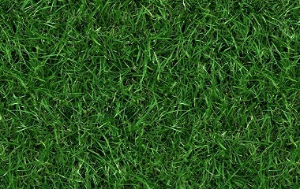
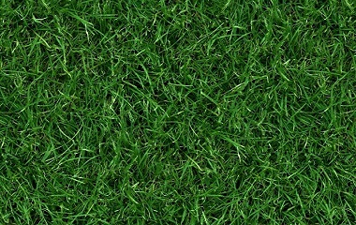
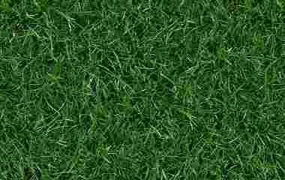

Reference
SWD_pixel SWD_vgg
0.0019 0.0514
0.021 0.3056
0.081 0.4824

Slide 7
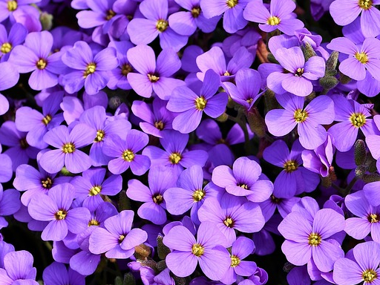
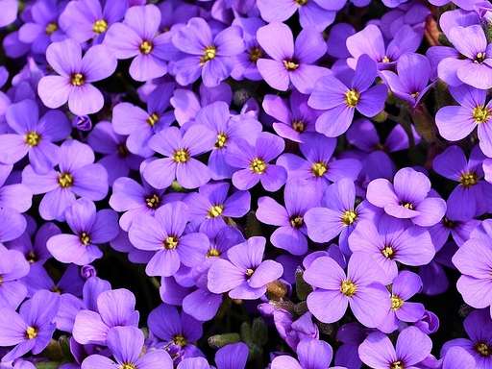
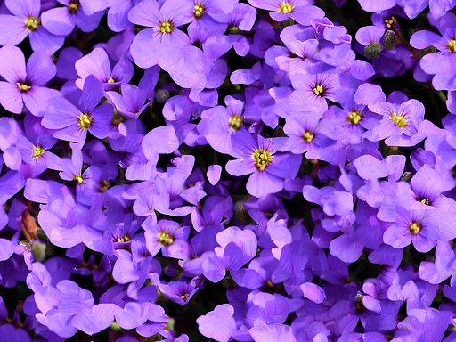

0.0063 0.1425
0.022 0.3640
0.0445 0.8268

Slide 8
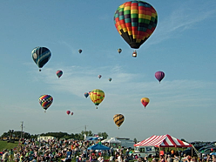
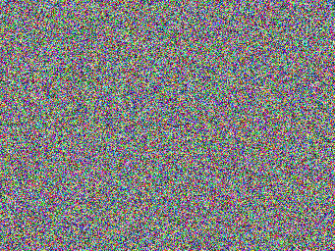
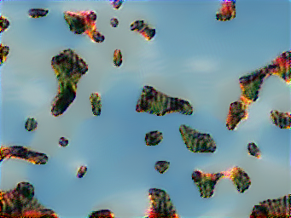
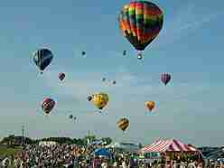
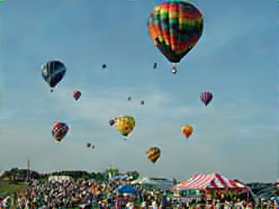
Optimization
Recovery example
Reference
Initialization
Recovered

Slide 9
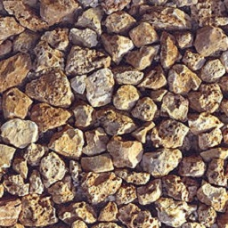
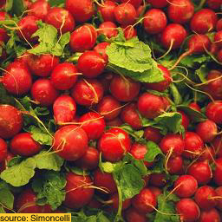
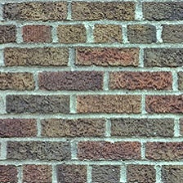
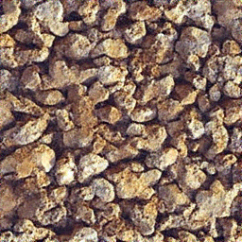
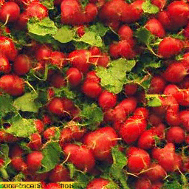
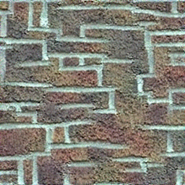
Optimization
Recovery example
Texture Synthesis Using Shallow Convolutional Networks with Random Filters
Reference
Recovered image
from random noise

Slide 10
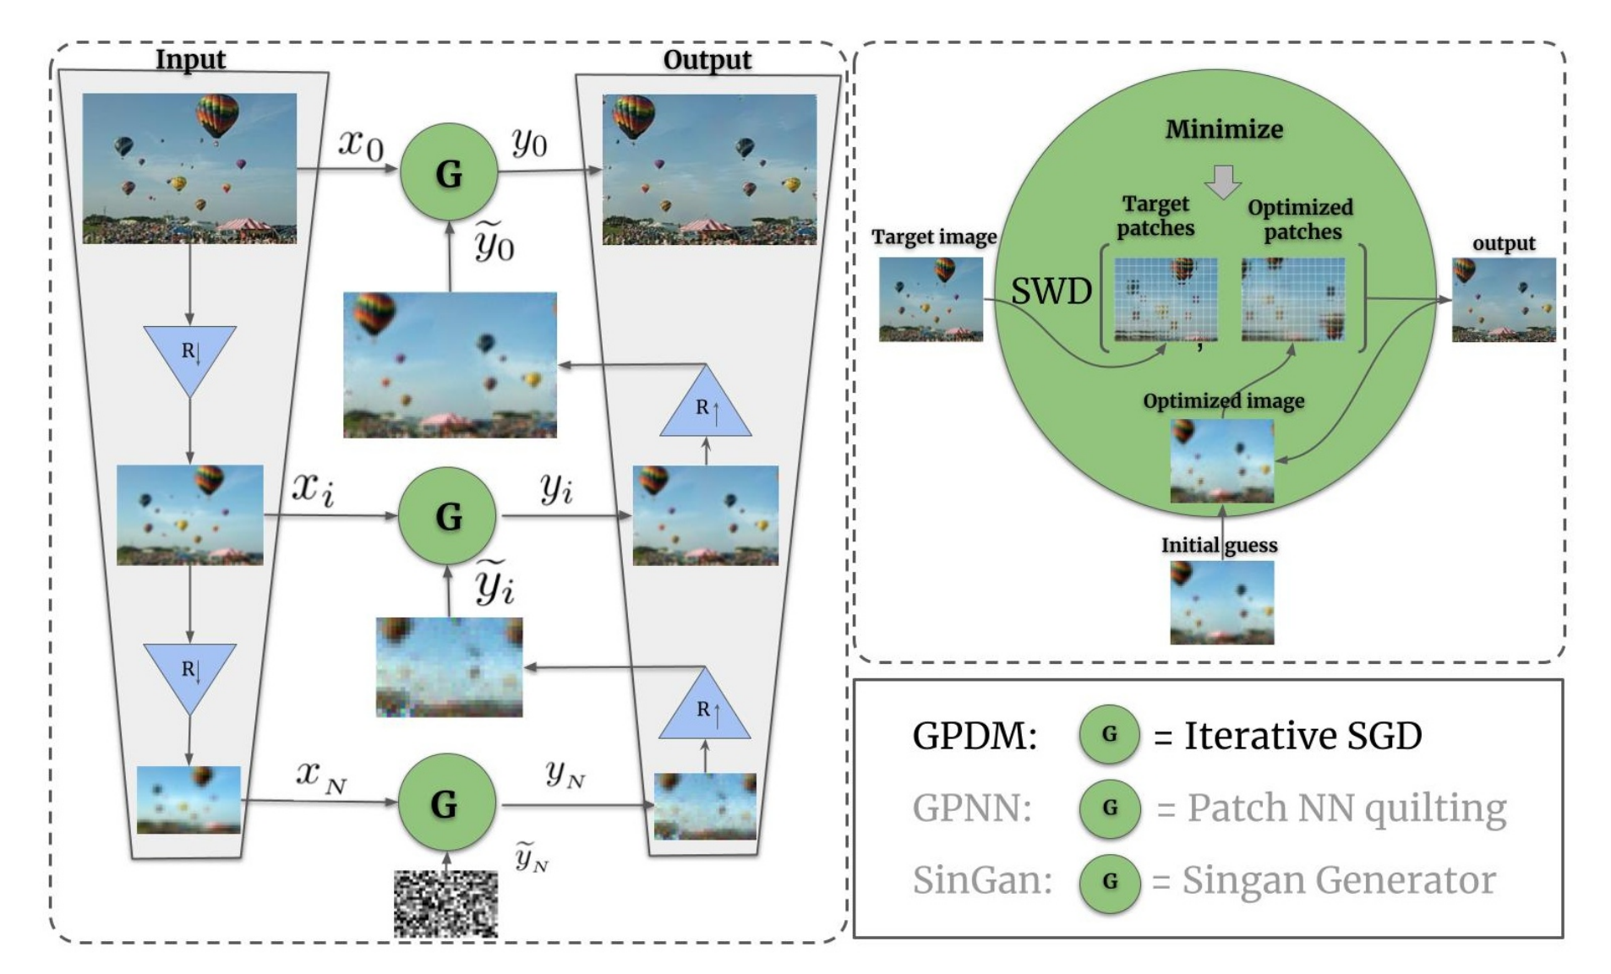
Generating Natural images with direct Patch Distributions Matching
reshuffling

Slide 11
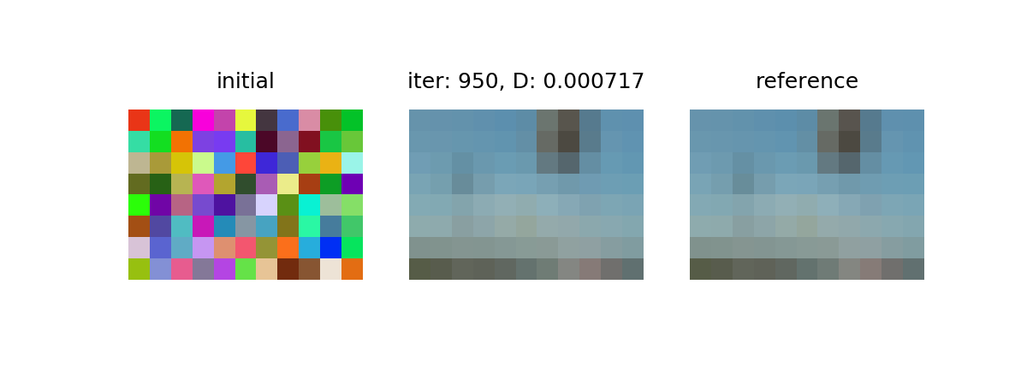
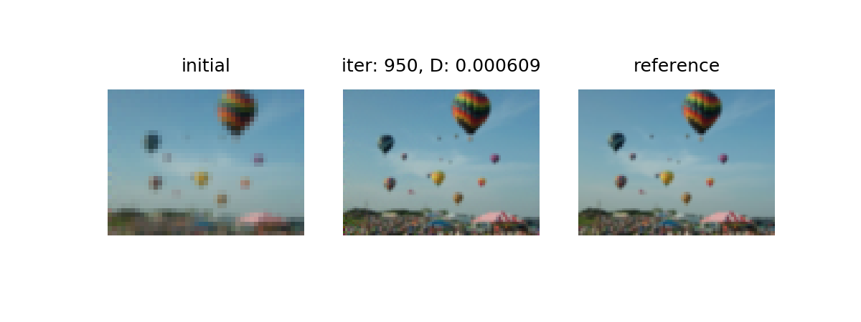
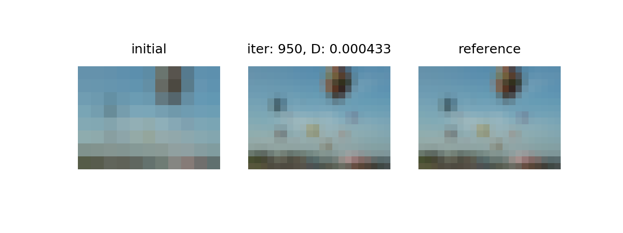
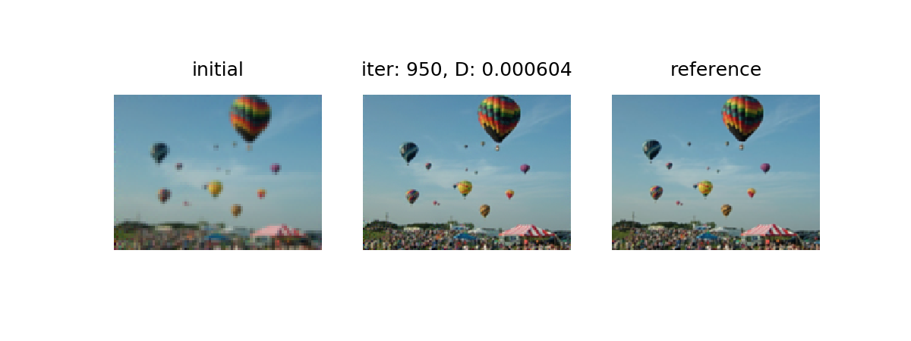
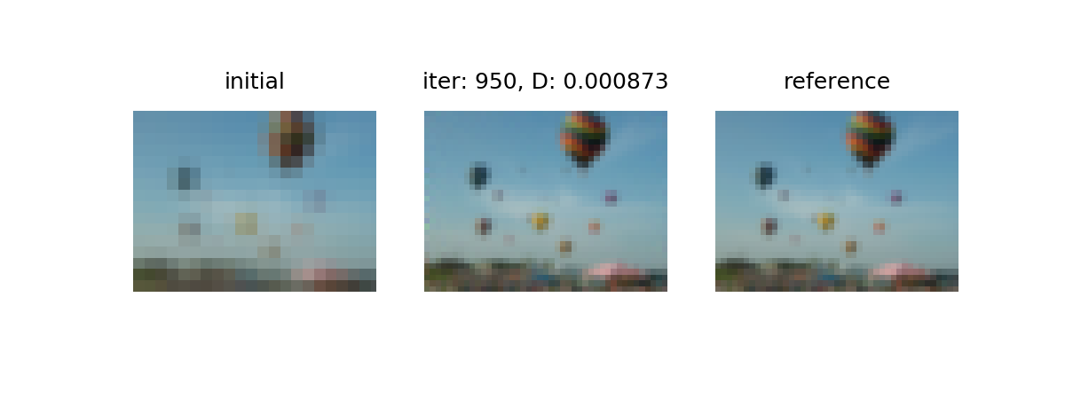
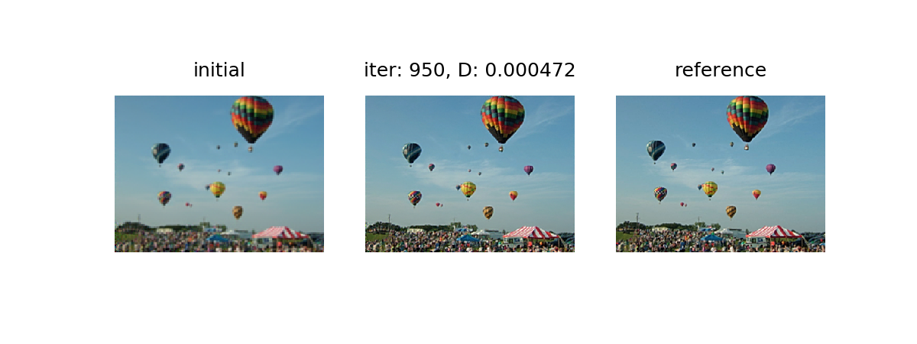
1
2
3
4
5
6

Slide 12
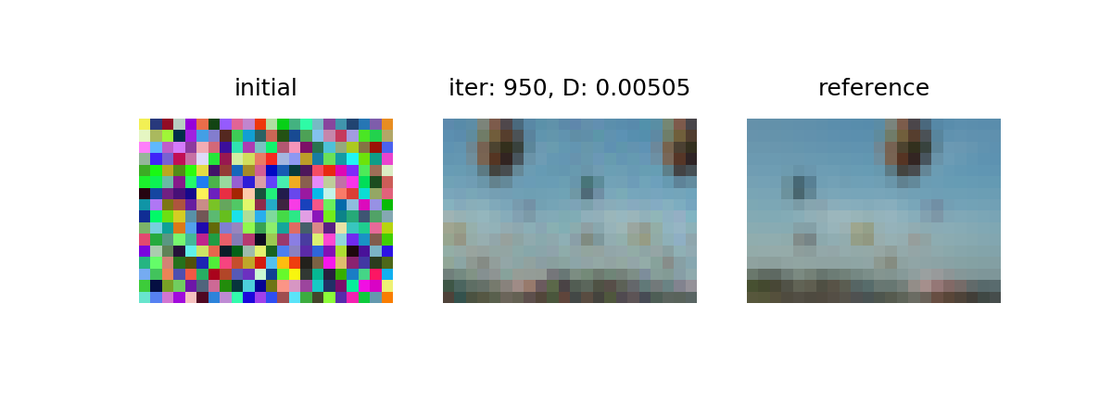
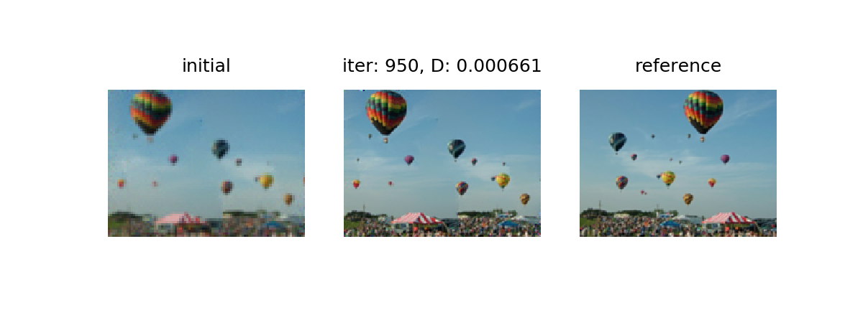
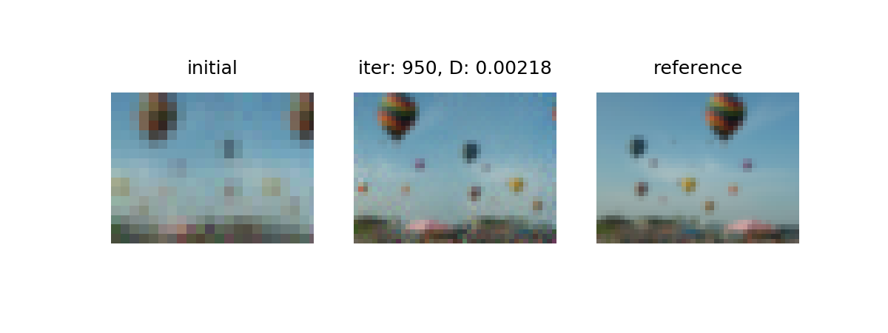
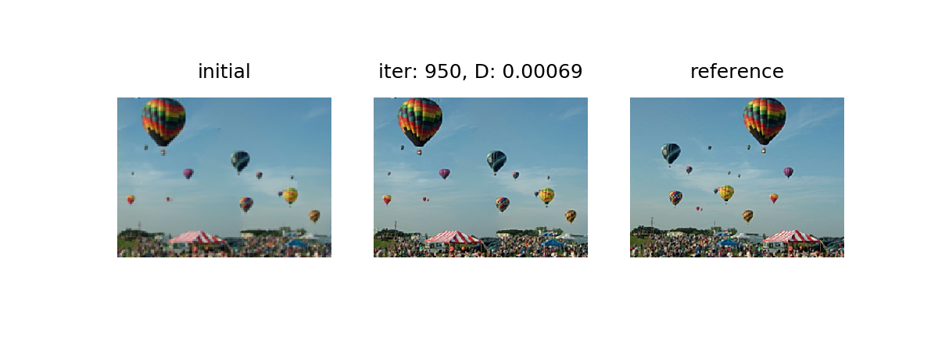


Slide 13
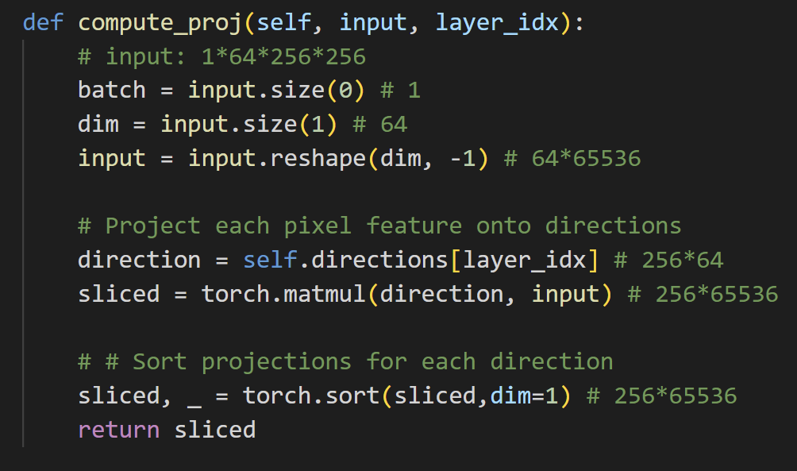

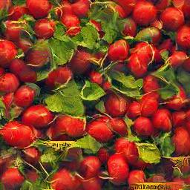
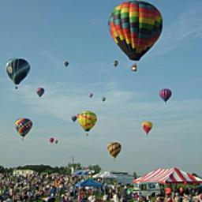
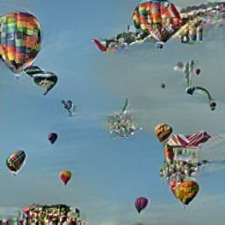
A Sliced Wasserstein Loss for Neural Texture Synthesis
For our experiments, we use the first L = 12 convolutional layers of a pretrained VGG-19 with normalized weights.
1. 256*65536
2. 256*65536
3. 256*16384
4. 256*16384
5. 256*4096
6. 256*4096
7. 256*4096
8. 256*4096
9. 256*1024
10. 256*1024
11. 256*1024
12. 256*1024

Slide 14
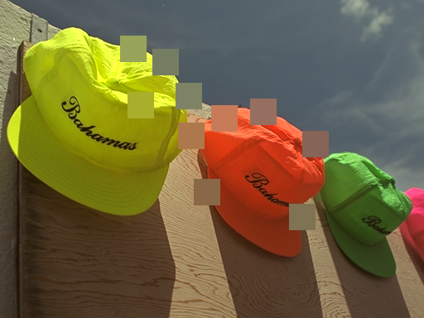
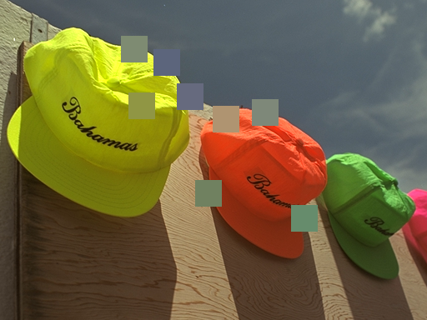
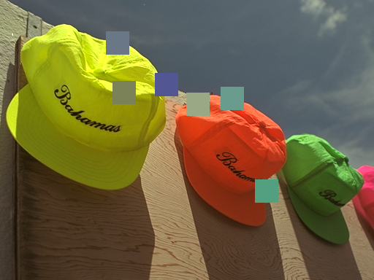
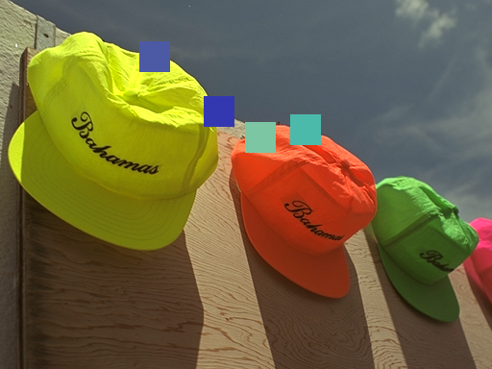
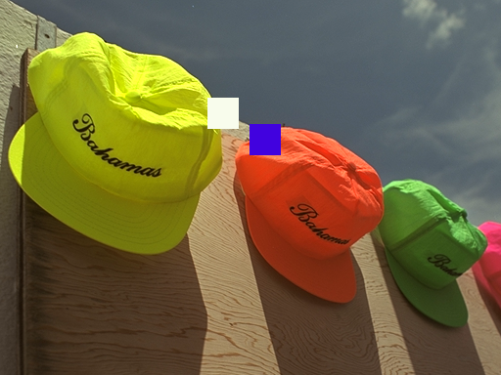
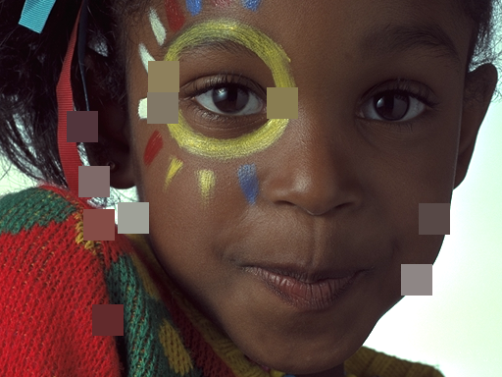
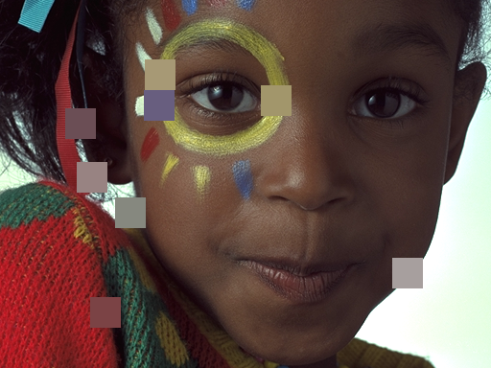
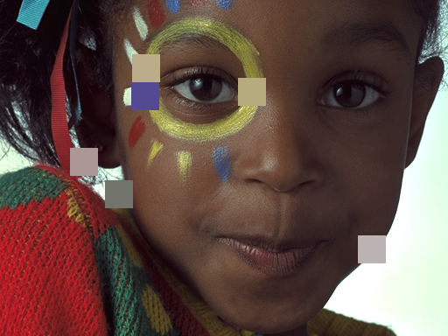
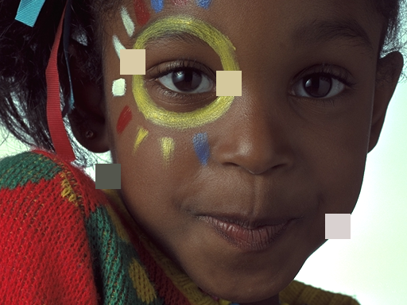
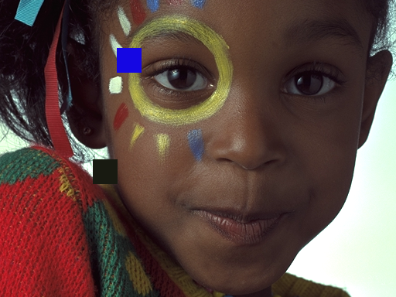
0.58 0.109 0.091 0.086 0.050
0.098 0.096 0.077 0.064 0.052

Slide 15
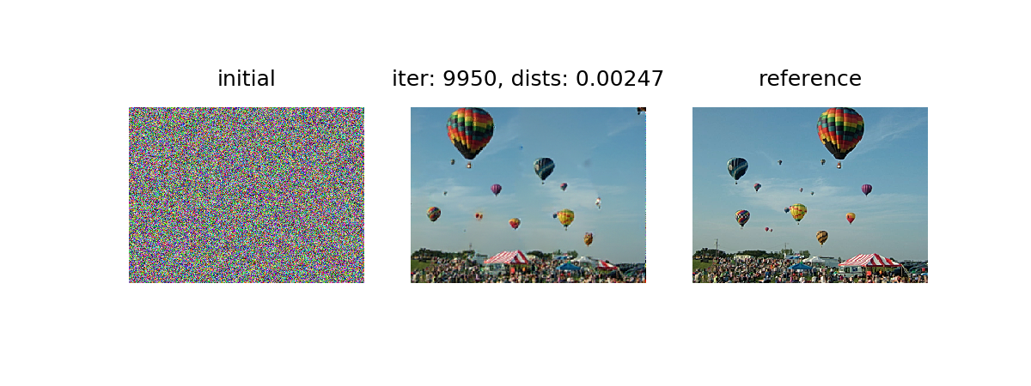
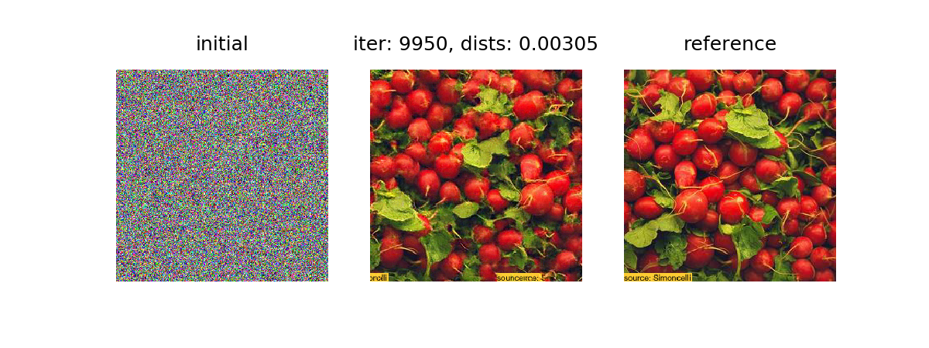
Optimization
Gaussian Pyramid
stages = 5

Slide 16
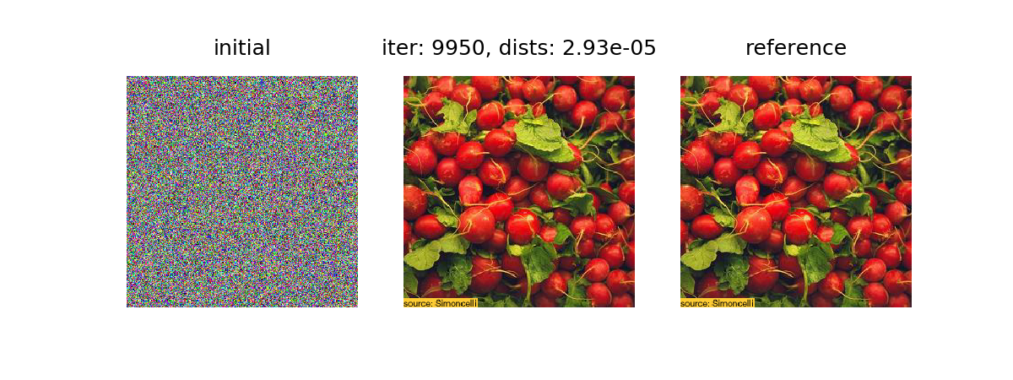
Gaussian Pyramid
stages = 6

Slide 17
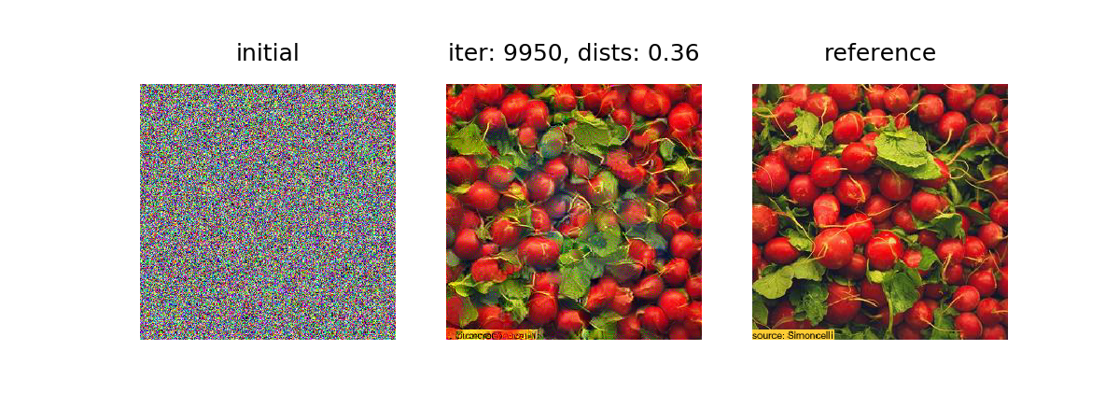
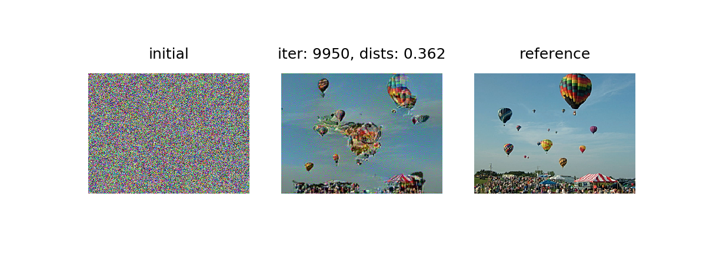
VGG

Slide 18
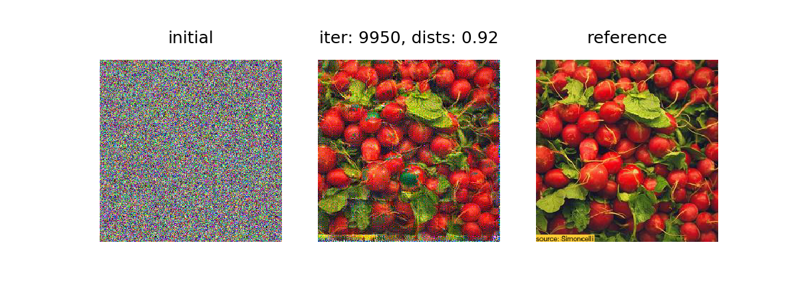

EffNet

Slide 19


PNAS

Slide 20


Gaussian Pyramid + VGG
I:
g4
g5
g3
g2
g1
Gaussian Pyramid
（Pixels）
II:
f3
f4
f5
f2
f1
VGG features
 | LIVE | CSIQ | TID2013 | KADID | TQD
I: without stage weights (average, no training) | 0.904 | 0.887 | 0.643 | 0.712 | 0.845
II: with stage weights [0.0345, 0.0715, 0.0785, 0.0852, 0.0991; 0.0557, 0.0131, 0.0031, 0.2199, 0.2660] | 0.906 | 0.903 | 0.693 | 0.748 | 0.886

Slide 21


Single image generation using SWD
CNN
16*16*3
output
(256*256*3）
reference
SWD loss

Slide 22








SWD_Gau_Pyr, 4 satges, kernel 128*3*5*5

Slide 23








SWD_Gau_Pyr, 4 satges, kernel 128*3*5*5

Slide 24








SWD_vgg, 5 stages, kernel 128*(X)*3*3

Slide 25








SWD_vgg, 5 stages, kernel 128*(X)*3*3

Slide 26


SWD applied to Denoising
SWD_Gau_Pyr, 5 stages, kernel 128*3*5*5
input output GT
Loss 0.014

Slide 27


SWD applied to Denoising
SWD_Gau_Pyr, 5 stages, kernel 128*3*5*5
Without sorting
input output GT

Slide 28


SWD applied to Denoising
SWD_Gau_Pyr, 5 stages, kernel 128*3*5*5
Pretrained
input output GT
Loss 0.012

Slide 29


SWD applied to Denoising
SWD_vgg, 5 stages, kernel 128*(X)*3*3
input output GT

Slide 30



SWD applied to Denoising
SWD_Gau_Pyr, 5 stages, kernel 128*3*5*5
Single image training
input output GT
Loss 0.001

Slide 31


SWD applied to Super-resolution
SWD_Gau_Pyr, 5 stages, kernel 128*3*5*5
input output GT

Slide 32


SWD applied to Super-resolution
SWD_vgg, 5 stages, kernel 128*(X)*3*3
input output GT

Slide 33



SWD_Gau_Pyr
A
 | directions | patchsize | stride
A | 64 | 7 | 1
B | 64 | 3 | 1
C | 64 | 1 | 1
B
patchsize should be >1
C

Slide 34


SWD_Gau_Pyr
A
 | directions | patchsize | stride
A | 64 | 3 | 1
B | 32 | 3 | 1
C | 8 | 3 | 1
B
Less directions, more iterations are needed to achieve the similar results.
C

Slide 35



SWD_Gau_Pyr
A
 | directions | patchsize | stride
A | 64 | 7 | 1
B | 64 | 7 | 3
C | 64 | 7 | 5
D | 64 | 7 | 7
B
Stride should be < patchsize
D
C

Slide 36
An image 256*256 | directions | patchsize | stride | stages | iterations | time(s)
GPDM (default) | 64 | 7 | 1 | 15 | 4500 total | 9.79
GPDM | 64 | 7 | 1 | 5 | 1500 total | 3.45
Ours | 64 | 7 | 1 | 5 | 4500 | 45.55
Ours | 64 | 7 | 1 | 5 | 1500 | 15.27
GPDM need less iterations.
With the same iterations, GPDM costs less time.

Slide 37






Visual results
GPDM (5 stages, 3.45 seconds)
Ours (5 stages, 1500 iterations (not enough),
15.27 seconds)
Ours (5 stages, 4500 iterations, 45.55 seconds)

Slide 38
Summary
DNN-based multi-scale SWD metric
IQA (SRCC)
Applciations (Loss function):
1. aligned data, eg, Super-resolution
2. nonaligned data, eg, ...
3. single image synthesis,eg,texture
Compared to DISTS, It can also be applied to optimizing non-aligned visual tasks
Compared to GPDM, ...

